Slide 1
Forecasting
L and T – Spare Parts
Vishnuprasad Nagadevara
nagadev@iimb.ac.in

Slide 2
Introduction
L&T has been in the construction and mining business for three decades.
It also provides spare parts and after-sales service to customers to improve utilization and helps them to obtain the best possible value.
The spare parts business of construction and mining equipment has a profitability of around 30%, while the equipment business has profitability of around 7%.
There are over 20,000 different types of spare parts and forecasting the demand of each part is a challenge.
Technology changes frequently and superseding parts that have a different material, a different design, or improved quality are developed such that these can replace the previous parts.
New machines that are developed require additional spare parts.
Demand sometimes is seasonal since most of the customers plan their annual overhaul during the monsoon season, when construction is virtually at a standstill.

Slide 3
History
L&T was founded in Bombay (Mumbai) in 1938 by two Danish engineers, Henning Holck-Larsen and Soren Kristian Toubro.
Started operations by representing Danish dairy equipment manufacturers and World War II forced the founders to manufacture equipment indigenously.
The war created opportunities for repairing ships, which led to the formation of repair and fabrication shops.
The company grew into an engineering major under the guidance of several eminent leaders.
Has presence in several businesses - infrastructure, defense, aerospace, hydrocarbons, heavy engineering, construction, power, mining and metallurgy, electrical and automation products, machinery and industrial products, information technology, financial services, ship building, and railway projects
Has 137 subsidiaries and 16 associated companies;
The L&T Group had gross revenues of INR 752 billion (USD 13 billion) in CY 2013 and 22.49 Billion in 2023

Slide 4
Spare Parts at Construction and Mining Business (CMB)
Supply through its central warehouse at Nagpur.
Has four fully equipped service stations at Chennai, Delhi, Durgapur, and Pune, which catered to the southern, northern, eastern, and western regions of the country, respectively.
The facility at Nagpur catered to the central region.
There were 58 sub-service centers under the fully equipped service centers and 26 dealers who had 84 outlets across the country.
The spare parts of the construction equipment were generally supplied through the dealers, while the mining equipment spare parts were supplied via a mix of service centers and dealer outlets.
The spare parts were classified into six main categories: filters, engine maintenance parts, seals and hoses, v-belts, undercarriage, and ground engaging tools

Slide 5
Spare Parts Classification
Filters | Engine Maintenance Parts | Seals & Hoses | Undercarriage | Ground Engaging Tools | V-Belts
Engine Filters | Gasket Kits | Hydraulic Hoses | Track-Links | Bucket Teeth | V-Belts
1000-Hour Filters | Rain Caps | O-Rings | Sprocket Teeth | Cutting Edges
Fuel Filters | Exhaust Pipe | Oil Seals | Track Shoes | Blades
Oil Filters | Mufflers | Fuel Hoses | Rollers | Side Cutters
Air Cleaner | Cylinder Liners | Dust Seals | Idlers
Corrosion Resistor | Pistons | Seal Washers
Hydraulic Filter | Piston Rings Thermostat | Low Pressure Heads
 | Fuel Water Separators | Water Hoses Hose Clamps
 |  | Back-up Rings

Slide 6
Item Selected: 07063-51210I
Month | Quantity | Month | Quantity | Month | Quantity | Month | Quantity
Apr-2009 | 435 | Apr-2010 | 334 | Apr-2011 | 437 | Apr-2012 | 485
May-2009 | 349 | May-2010 | 458 | May-2011 | 461 | May-2012 | 539
Jun-2009 | 339 | Jun-2010 | 416 | Jun-2011 | 595 | Jun-2012 | 622
Jul-2009 | 338 | Jul-2010 | 326 | Jul-2011 | 540 | Jul-2012 | 509
Aug-2009 | 389 | Aug-2010 | 373 | Aug-2011 | 541 | Aug-2012 | 434
Sep-2009 | 294 | Sep-2010 | 460 | Sep-2011 | 497 | Sep-2012 | 549
Oct-2009 | 322 | Oct-2010 | 344 | Oct-2011 | 461 | Oct-2012 | 446
Nov-2009 | 407 | Nov-2010 | 465 | Nov-2011 | 491 | Nov-2012 | 447
Dec-2009 | 432 | Dec-2010 | 484 | Dec-2011 | 587 | Dec-2012 | 532
Jan-2010 | 387 | Jan-2011 | 527 | Jan-2012 | 490 | Jan-2013 | 515
Feb-2010 | 438 | Feb-2011 | 421 | Feb-2012 | 416 | Feb-2013 | 629
Mar-2010 | 577 | Mar-2011 | 567 | Mar-2012 | 613 | Mar-2013 | 494
 |  |  |  |  |  | Apr-2013 | 500

Slide 7
Pattern

Slide 8
Seasonal Index
 | 2009 | 2010 | 2011 | 2012 | Average | Index
Apr | 435 | 334 | 437 | 485 | 422.75 | 91.36%
May | 349 | 458 | 461 | 539 | 451.75 | 97.62%
Jun | 339 | 416 | 595 | 622 | 493 | 106.54%
Jul | 338 | 326 | 540 | 509 | 428.25 | 92.54%
Aug | 389 | 373 | 541 | 434 | 434.25 | 93.84%
Sep | 294 | 460 | 497 | 549 | 450 | 97.24%
Oct | 322 | 344 | 461 | 446 | 393.25 | 84.98%
Nov | 407 | 465 | 491 | 447 | 452.5 | 97.78%
Dec | 432 | 484 | 587 | 532 | 508.75 | 109.94%
Jan | 387 | 527 | 490 | 515 | 479.75 | 103.67%
Feb | 438 | 421 | 416 | 629 | 476 | 102.86%
Mar | 577 | 567 | 613 | 494 | 562.75 | 121.61%
 |  |  |  |  | 462.75 | 100.00%

Slide 9
ANOVA
ANOVA
Source of Variation | SS | df | MS | F | P-value | F crit
Between Groups | 89268 | 11 | 8115.273 | 1.118264 | 0.376069 | 2.066608
Within Groups | 261253 | 36 | 7257.028
Total | 350521 | 47

Slide 10
Regression
Regression Statistics
Multiple R | 0.7793
R Square | 0.6073
Adjusted R Square | 0.4764
Standard Error | 61.9576
Observations | 49
 | Coefficients | Standard Error | t Stat | P-value
Intercept | 310.8544 | 35.42224 | 8.775684 | 1.8E-10
Dummy2 | 27.19417 | 41.62962 | 0.653241 | 0.517752
Dummy3 | 68.44417 | 41.62962 | 1.644122 | 0.108857
Dummy4 | 3.694175 | 41.62962 | 0.088739 | 0.929781
Dummy5 | 9.694175 | 41.62962 | 0.232867 | 0.817183
Dummy6 | 25.44417 | 41.62962 | 0.611204 | 0.544905
Dummy7 | -31.3058 | 41.62962 | -0.75201 | 0.456935
Dummy8 | 27.94417 | 41.62962 | 0.671257 | 0.506341
Dummy9 | 84.19417 | 41.62962 | 2.022458 | 0.050607
Dummy10 | 55.19417 | 41.62962 | 1.325839 | 0.193245
Dummy11 | 51.44417 | 41.62962 | 1.235759 | 0.224551
Dummy12 | 138.1942 | 41.62962 | 3.319612 | 0.002072
Trend | 45.48058 | 7.881345 | 5.770663 | 1.41E-06
ANOVA
 | df | SS | MS | F | Significance F
Regression | 12 | 213685 | 17807.12 | 4.639 | 0.00016
Residual | 36 | 138194 | 3838.744
Total | 48 | 351880

Slide 11
Regression Results
Model | Unstandardized Coefficients |  | Standardized Coefficients | t | Sig.
 | B | Std. Error | Beta
(Constant) | 370.628 | 17.615 |  | 21.040 | .000
Trend (M) | 3.674 | .609 | .613 | 6.035 | .000
Dummy12 | 81.906 | 31.570 | .265 | 2.594 | .013
Dummy7 | -69.225 | 31.394 | -.224 | -2.205 | .033

Slide 12
Regression Fit

Slide 13
Simple Exponential Smoothing
Model | Number of Predictors | Model Fit statistics | Ljung-Box Q(18) |  |  | Number of Outliers
 |  | Stationary R-squared | Statistics | DF | Sig.
Quantity-Model_1 | 0 | .436 | 23.181 | 17 | .143 | 0
Fit Statistic | Mean | SE | Minimum | Maximum
Stationary R-squared | .436 |  | .436 | .436
R-squared | .316 |  | .316 | .316
RMSE | 70.809 |  | 70.809 | 70.809
MAPE | 12.521 |  | 12.521 | 12.521
MaxAPE | 32.454 |  | 32.454 | 32.454
MAE | 57.941 |  | 57.941 | 57.941
MaxAE | 187.261 |  | 187.261 | 187.261
Normalized BIC | 8.599 |  | 8.599 | 8.599
Model |  |  | Estimate | SE | t | Sig.
Quantity-Model_1 | No Transformation | Alpha | .205 | .087 | 2.356 | .023

Slide 14
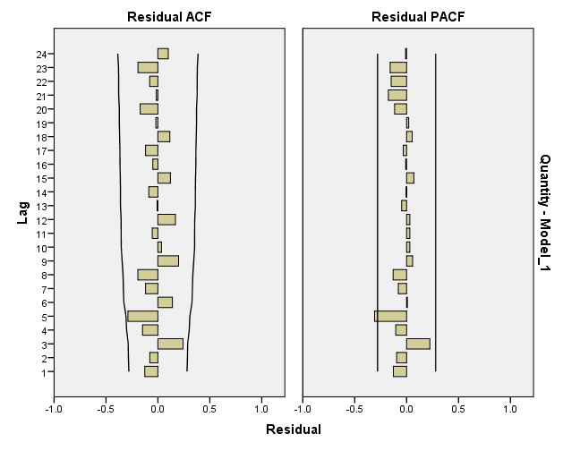
Residual ACF and PACF

Slide 15
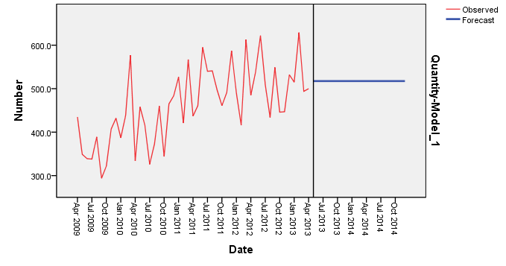
Forecasts

Slide 16
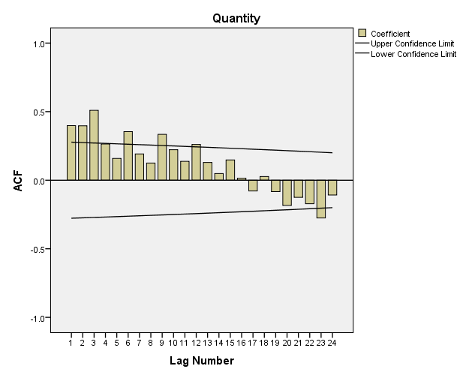
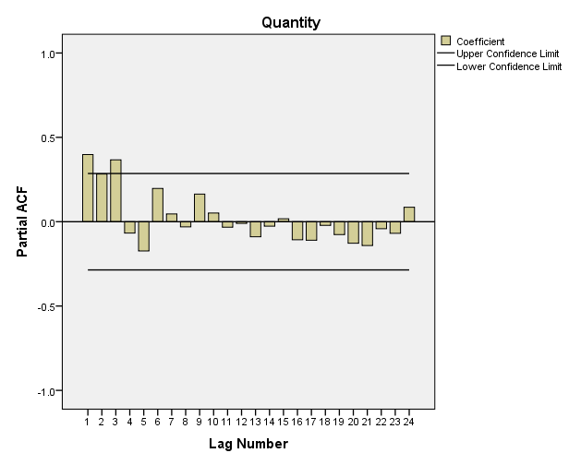
ACF and PACF

Slide 17
Augmented Dicky – Fuller Test
adf.test(qty.ts)
Augmented Dickey-Fuller Test
data: qty.ts
Dickey-Fuller = -2.665, Lag order = 3, p-value = 0.3081
alternative hypothesis: stationary
Take first Difference: Y_{t} – Y_{t-1}
Augmented Dickey-Fuller Test (After first difference)
data: diff.ts
Dickey-Fuller = -4.1315, Lag order = 3, p-value = 0.01155
alternative hypothesis: stationary

Slide 18
Holt-Winters
Model | Number of Predictors | Model Fit statistics | Ljung-Box Q(18) |  |  | Number of Outliers
 |  | Stationary R-squared | Statistics | DF | Sig.
Quantity-Model_1 | 0 | .779 | 11.654 | 15 | .705 | 0
Fit Statistic | Mean | SE | Minimum | Maximum
Stationary R-squared | .779 |  | .779 | .779
R-squared | .589 |  | .589 | .589
RMSE | 56.088 |  | 56.088 | 56.088
MAPE | 9.678 |  | 9.678 | 9.678
MaxAPE | 28.041 |  | 28.041 | 28.041
MAE | 43.353 |  | 43.353 | 43.353
MaxAE | 138.521 |  | 138.521 | 138.521
Normalized BIC | 8.292 |  | 8.292 | 8.292
Model |  |  | Estimate | SE | t | Sig.
Quantity-Model_1 | No Transformation | Alpha (Level) | .099 | .082 | 1.213 | .231
 |  | Gamma (Trend) | 2.019E-05 | .026 | .001 | .999
 |  | Delta (Season) | .001 | .140 | .007 | .994

Slide 19
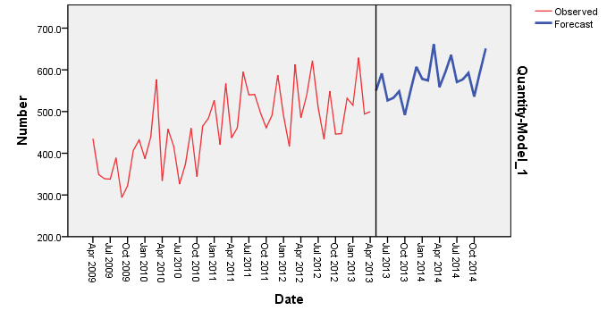
Forecast (Winter)

Slide 20
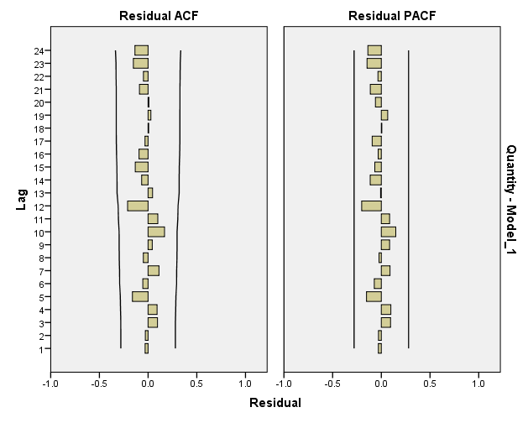
Residuals (Winter)

Slide 21
ARIMA
ARIMA Expert (Auto ARIMA suggested ARIMA (0, 0, 1)
Series not stationary (ADF Test)
Should use difference (1)
ARIMA (1, 1, 1)
ARIMA (2, 1, 0)

Slide 22
ARIMA (1, 1, 1)
Model | Number of Predictors | Model Fit statistics | Ljung-Box Q(18) |  |  | Number of Outliers
 |  | Stationary R-squared | Statistics | DF | Sig.
Quantity-Model_1 | 0 | .468 | 16.481 | 16 | .420 | 0
Fit Statistic | Mean | SE | Minimum | Maximum
Stationary R-squared | .468 |  | .468 | .468
R-squared | .362 |  | .362 | .362
RMSE | 70.549 |  | 70.549 | 70.549
MAPE | 12.522 |  | 12.522 | 12.522
MaxAPE | 31.014 |  | 31.014 | 31.014
MAE | 56.479 |  | 56.479 | 56.479
MaxAE | 178.949 |  | 178.949 | 178.949
Normalized BIC | 8.755 |  | 8.755 | 8.755
 |  |  |  |  | Estimate | SE | t | Sig.
Model_1 | Quantity | No Transformation | Constant |  | 3.894 | .923 | 4.217 | .000
 |  |  | AR | Lag 1 | -.014 | .161 | -.088 | .930
 |  |  | Difference |  | 1
 |  |  | MA | Lag 1 | .998 | 2.691 | .371 | .712

Slide 23
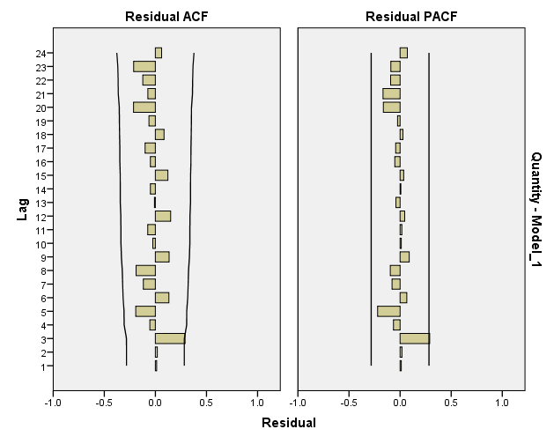
Residuals

Slide 24
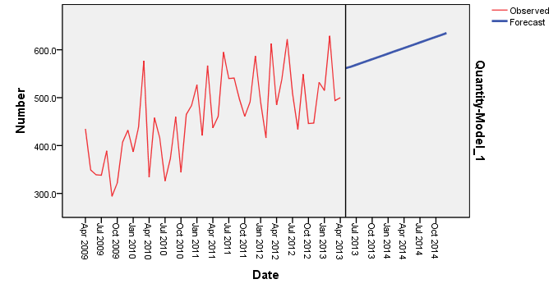
Forecasts

Slide 25
ARIMA (2, 1, 0)
Model | Number of Predictors | Model Fit statistics | Ljung-Box Q(18) |  |  | Number of Outliers
 |  | Stationary R-squared | Statistics | DF | Sig.
Quantity-Model_1 | 0 | .456 | 8.665 | 16 | .927 | 0
Fit Statistic | Mean | SE | Minimum | Maximum
Stationary R-squared | .456 |  | .456 | .456
R-squared | .348 |  | .348 | .348
RMSE | 71.332 |  | 71.332 | 71.332
MAPE | 13.203 |  | 13.203 | 13.203
MaxAPE | 34.094 |  | 34.094 | 34.094
MAE | 59.590 |  | 59.590 | 59.590
MaxAE | 148.071 |  | 148.071 | 148.071
Normalized BIC | 8.777 |  | 8.777 | 8.777
 |  |  |  |  | Estimate | SE | t | Sig.
Model_1 Quantity |  | No Transfor mation | Constant |  | 3.095 | 4.476 | .692 | .493
 |  |  | AR | Lag 1 | -.786 | .128 | -6.128 | .000
 |  |  |  | Lag 2 | -.530 | .130 | -4.082 | .000
 |  |  | Difference |  | 1

Slide 26
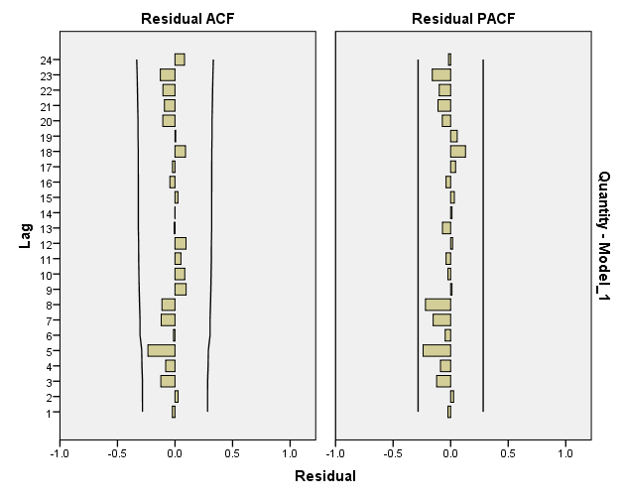
Residuals

Slide 27
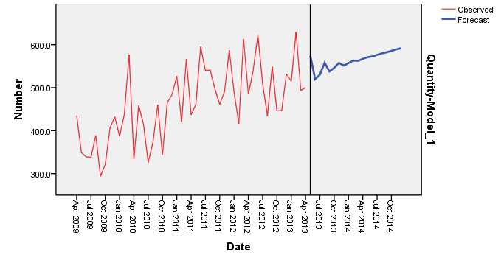
Forecasts

Slide 28
Combining Different Models Regression with intercept
Model | R | R Square | Adjusted R Square | Std. Error of the Estimate
1 | .791ª | .625 | .590 | 55.3351
 | Unstandardized Coefficients |  | Standardized Coefficients | t | Sig.
 | B | Std. Error | Beta
(Constant) | 35.235 | 67.352 |  | .523 | .604
Regression | .158 | .391 | .114 | .405 | .687
Winters | .899 | .351 | .749 | 2.563 | .014
Simple Exp | -.363 | .352 | -.250 | -1.030 | .309
ARIMA (2,1,0) | .212 | .290 | .166 | .731 | .469

Slide 29
Combining Different Models Regression without intercept
Multiple R | 0.9938
R Square | 0.9876
Adjusted R Square | 0.9640
Standard Error | 54.8765
Observations | 48.0000
 | Coefficients | Standard Error | t Stat | P-value
Intercept | 0 | #N/A | #N/A | #N/A
F_Reg | 0.2399 | 0.3555 | 0.6748 | 0.5033
F_Winters_Additive | 0.8460 | 0.3330 | 2.5403 | 0.0147
F_Simple_Exp | -0.3229 | 0.3410 | -0.9469 | 0.3489
F_ARIMA_210 | 0.2197 | 0.2873 | 0.7650 | 0.4484

Slide 30
Combining Different Models Regression without intercept
Model | R | R Square | Adjusted R Square | Std. Error of the Estimate
1 | .994ª | .987 | .987 | 54.8134
 | Unstandardized Coefficients |  | Standardized Coefficients | t | Sig.
 | B | Std. Error | Beta
Regression | .117 | .330 | .116 | .354 | .725
Winters | .868 | .332 | .869 | 2.616 | .012
ARIMA (2, 1, 0) | .009 | .181 | .009 | .047 | .962
 | Sum of Squares | df | Mean Square | F | Sig.
Regression | 1,05,54,695.97 | 3 | 35,18,231.99 | 1,170.98 | .000^{c}
Residual | 1,35,203.03 | 45 | 3,004.51
Total | 1,06,89,899.00 | 48

Slide 31
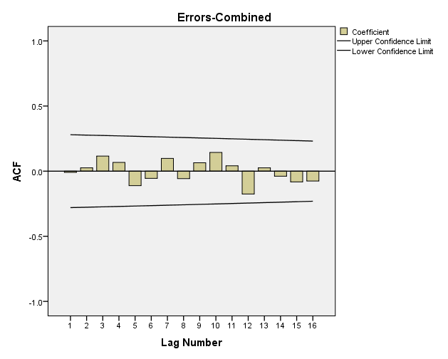
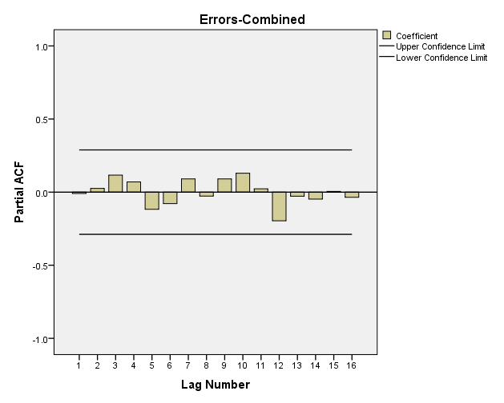
Residuals Combined

Slide 32
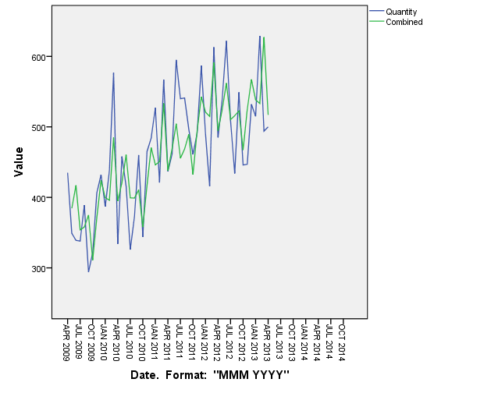
Combined

Slide 33
Model Comparison
 | Regression | Simple Exponential | Winter’s | ARIMA (1,1,1) | ARIMA (2,1,0) | Combined
Stationary R-squared |  | .436 | .779 | .468 | .456
R-squared | 0.607 | .316 | .589 | .362 | .348 | 0.987
RMSE | 61.958 | 70.809 | 56.088 | 70.549 | 71.332 | 53.073
MAPE | 0.101 | 12.521 | 9.678 | 12.522 | 13.203 | .0941
MaxAPE | 0.336 | 32.454 | 28.041 | 31.014 | 34.094 | .27
MAE | 45.372 | 57.941 | 43.353 | 56.479 | 59.590 | 42.5431
MaxAE | 134.880 | 187.261 | 138.521 | 178.949 | 148.071 | 133.24
Normalized BIC |  | 8.599 | 8.292 | 8.755 | 8.777

Slide 34
Questions?

